Slide 1
Results Check-In
20 August 2026

Slide 2
Goals
Confirmation on use of general linear mixed models
Insight on process of deduction/workflow with linear models
Talk over ideas of the LASSO test and review use and results of first attempt
Talk about general outline of thesis results

Slide 3
Summary-Sediment and Abiotic Variables
Merged USGS and Thesis Sediment Deposition data into one dataframe!
Thesis includes additional variables:
“local slope”
Extrapolated from marsh edge horizontal profile (June 2025) to the most recent RTK surveys of the transect (Nov. 2025-March 2025)
mean wind speed
Calculated per site, spanning time of Day filter was placed-Day filter was collected
USGS includes additional variables and elements:
Bay (Transects A, B) and Channel (Transects C, D) incorporated in data frames
Calculated z* to pair with thesis measurements
Used same BCDC stations as Thesis for standardization

Slide 4
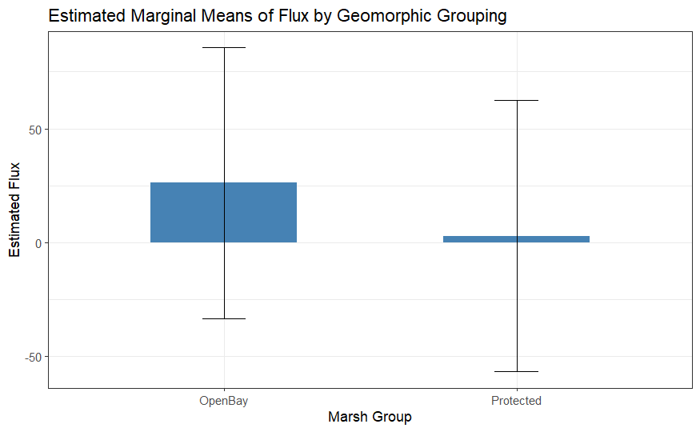
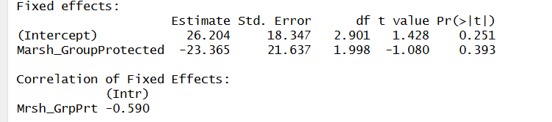
RQ # 1-Does marsh edge matter for sediment deposition?
Spatially-Protected and Open Bay
lmer(Flux ~ Marsh_Group + (1 | Site) + (1 | Tran)
“Open Bay” = San Pablo and Giant Marsh
“Protected” = Buck’s Landing and Corte Madera

Slide 5
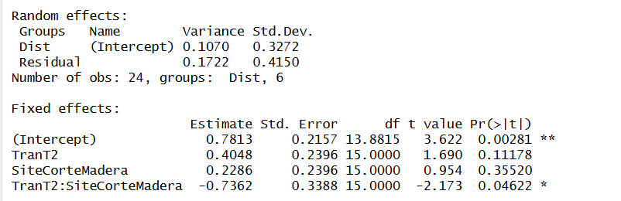
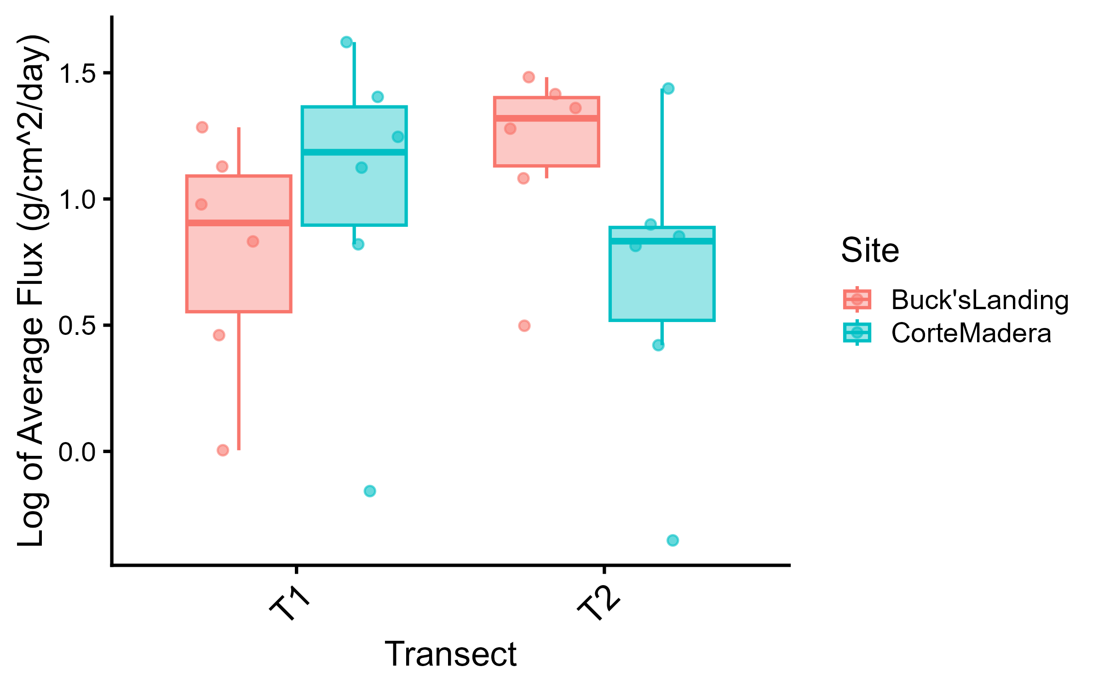
RQ # 1-Does marsh edge matter for sediment deposition?
Spatially-Protected Ramped and Scarped Sites
lmer(log(Flux) ~ Tran + Site + Tran*Site + (1|Dist)

Slide 6
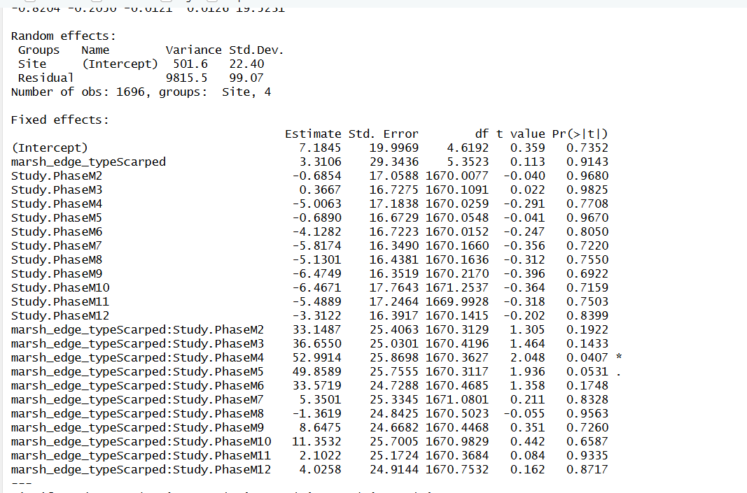
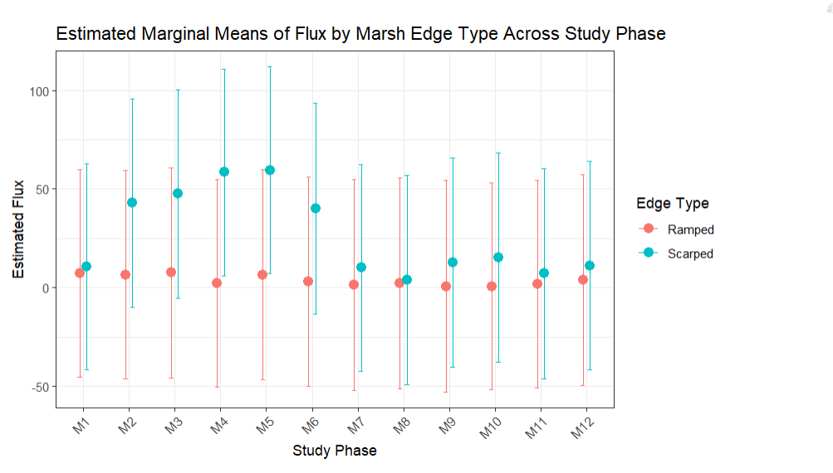
RQ # 1-Does marsh edge matter for sediment deposition?
Temporally-All Sites
lmer( Flux ~ marsh_edge_type * Study.Phase + (1|Site)

Slide 7
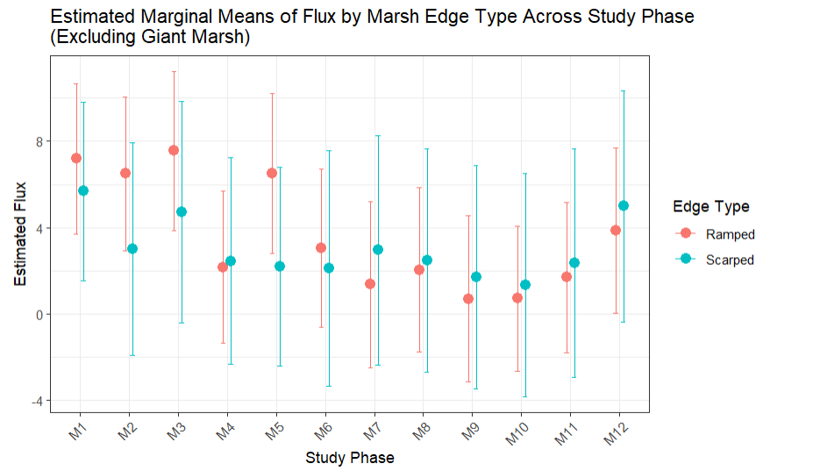
RQ # 1-Does marsh edge matter for sediment deposition?
Temporally-Excluding Giant Marsh
lmer( Flux ~ marsh_edge_type * Study.Phase + (1|Site)

Slide 8
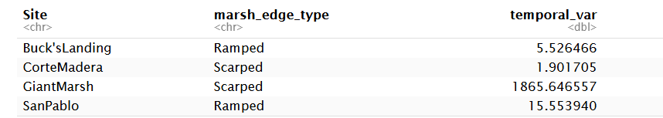
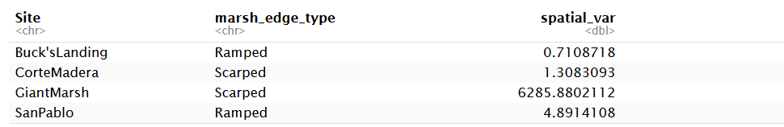
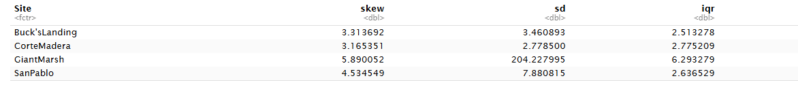
RQ # 1-Does marsh edge matter for sediment deposition?
Variance Between Sites
Temporally (Per Study Phase)
Spatially (Per Distance from Marsh Edge)
Skewness
leveneTest(Flux ~ Site, data)

Slide 9
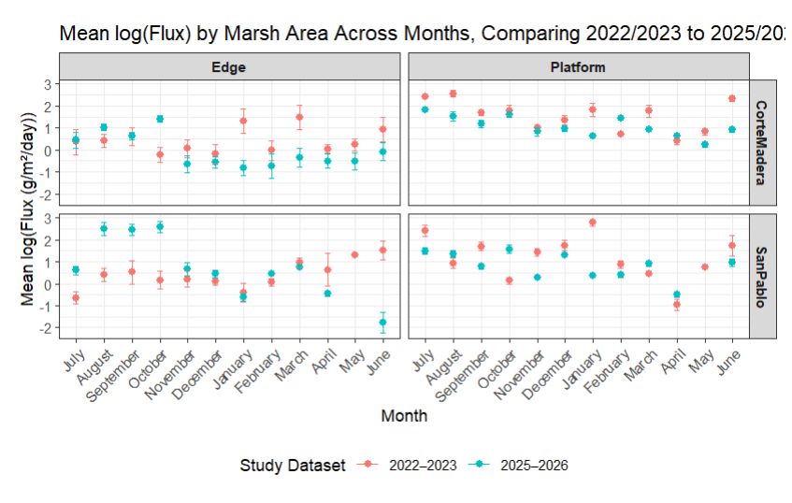
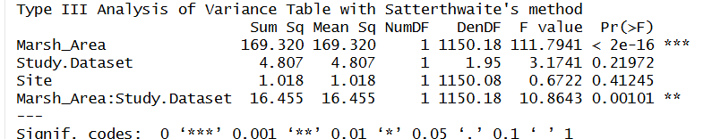
RQ #2: Do rates of sediment deposition change over time at the same edge type?
Spatially
log(Flux) ~ Marsh_Area * Study.Dataset + Site +(1|Tran)

Slide 10
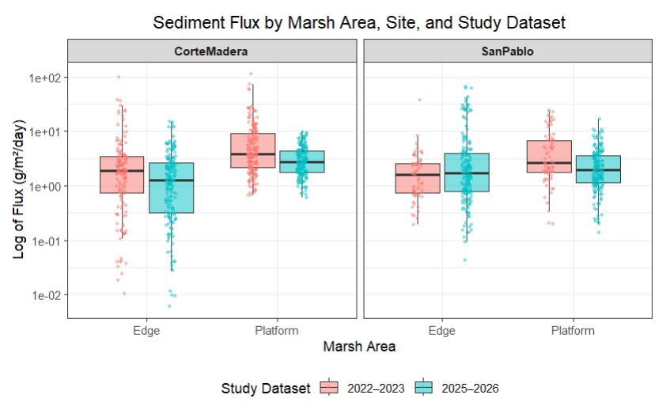
RQ #2: Do rates of sediment deposition change over time at the same edge type?
Spatially
lmer( log(Flux) ~ Study.Dataset * Month * Marsh_Area + (1|Tran)

Slide 11
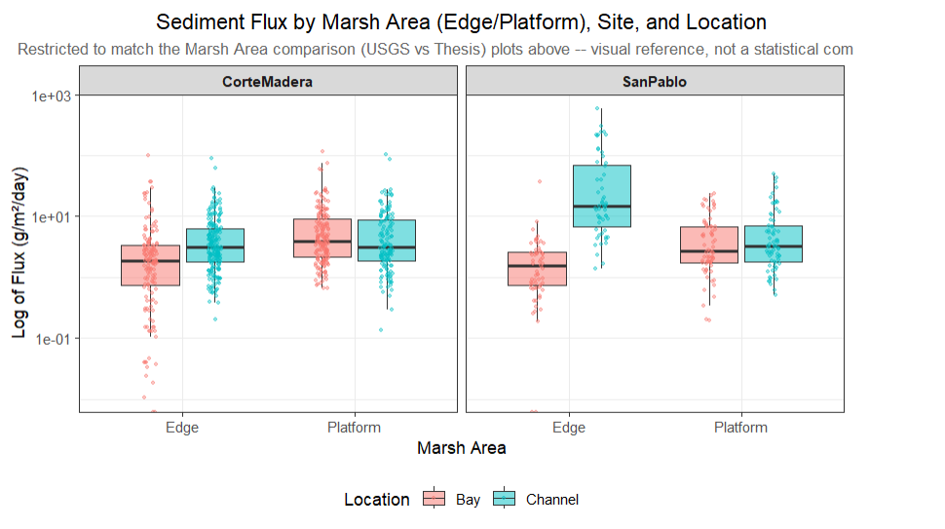
RQ #2: 2022/2023 Bay and Channel Transects

Slide 12
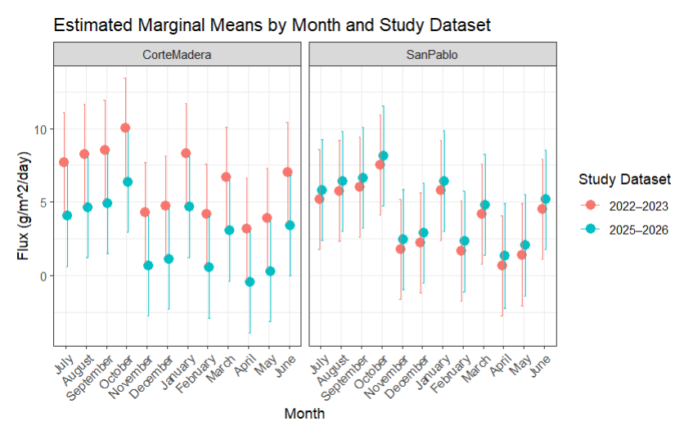
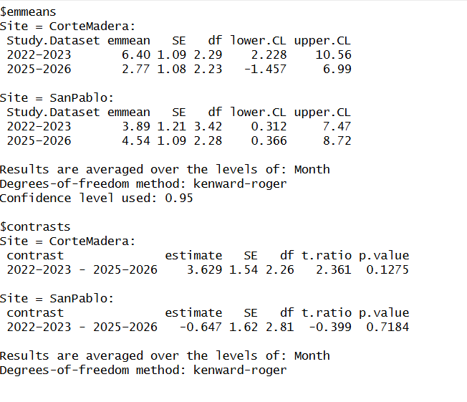
RQ #2: Do rates of sediment deposition change over time at the same edge type?
Temporally
lmer( Flux ~ Study.Dataset *Site + Month + (1 | Tran)

Slide 13
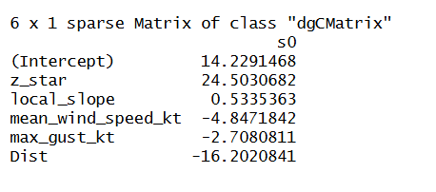
RQ# 3: Do inter-marsh variables explain more of the differences between sediment deposition?
LASSO (Least Absolute Shrinkage and Selection Operator) First Attempt (Thorne 2022).
Tried it out but still need to work through the theory of it.
Variables selected Against Flux. All predictors were standardized to zero for scaling.
Z star
Local Slope
Mean wind speed
Max gust
Distance from edge

